Slide 1


Presentation on “Heart Failure Prediction Using Machine Learning Models: A Comparative Study of Multiple Algorithms” [ID0132]
8th International Conference on “The Role of Statistics and Data Science in 4IR (ICRSDS4IR)”
Presented by:
Shishir Oyshi
Bachelor of Computer Science and Engineering
Department of Electrical & Computer Engineering, SEPS
North South University, Dhaka-1229, Bangladesh
Email: shishir.oyshi@northsouth.edu
Supervised by:
Dr. Md. Alamin
Assistant Professor
Department of Mathematics & Physics, SEPS
North South University, Dhaka-1229, Bangladesh
Email: md.alamin06@northsouth.edu
Date: 26th December 2024

Slide 2
Contents
Introduction
Objectives
Methods & Materials
Results & Discussion
Limitations
Future Work
References

Slide 3
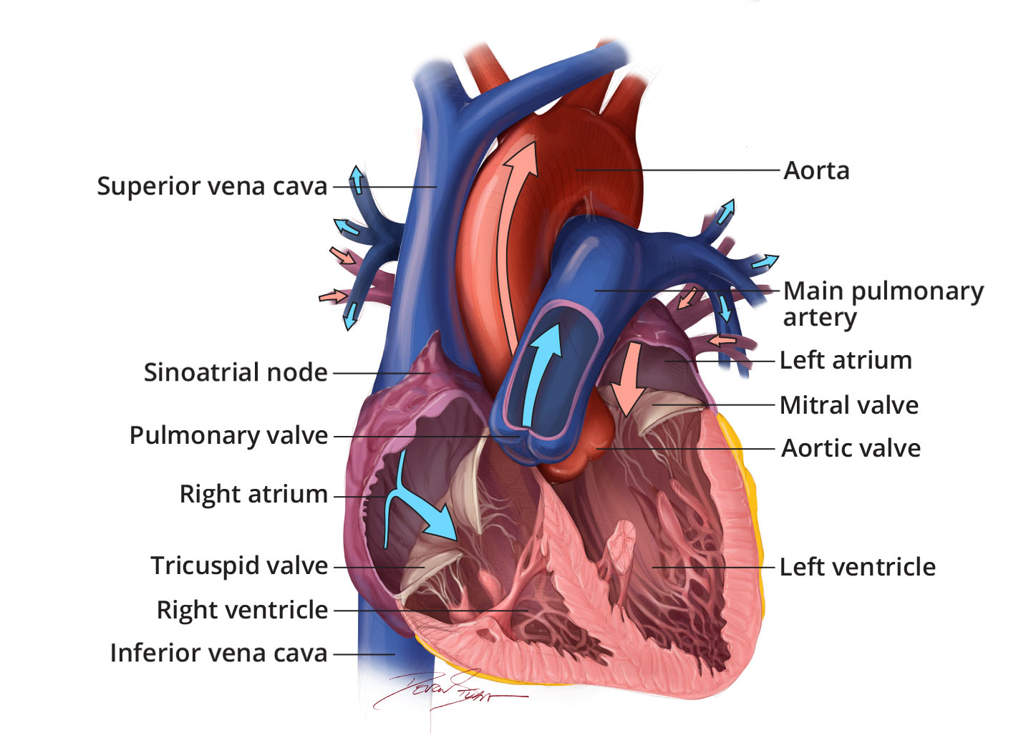
Introduction
Normal Heart Anatomy and Function:
Structure: The heart consists of four chambers: two atria (upper chambers) and two ventricles (lower chambers). Valves between these chambers ensure unidirectional blood flow.
Function: The right side of the heart pumps oxygen-poor blood to the lungs, while the left side pumps oxygen-rich blood to the rest of the body. This coordinated effort maintains efficient circulation.
Figure 1 : Anatomy of the interior of the heart. This image shows the four chambers of the heart and the direction that blood flows through the heart. Oxygen-poor blood, shown in blue-purple, flows into the heart and is pumped out to the lungs. Then oxygen-rich blood, shown in red, is pumped out to the rest of the body, with the help of the heart valves.
Source: familydoctor.org.
1

Slide 4
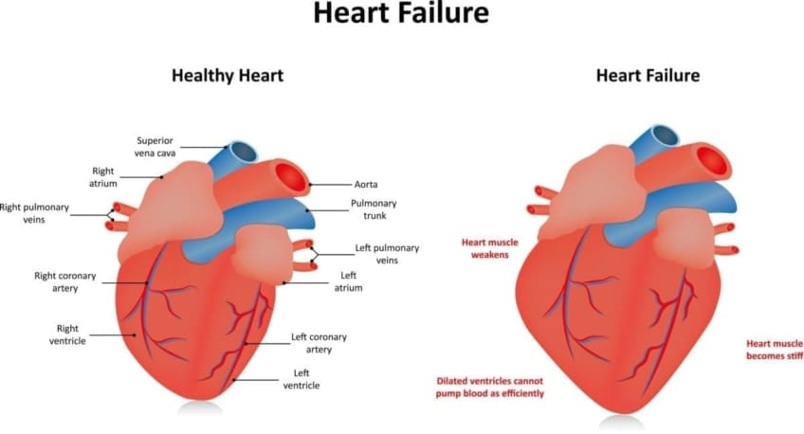
Introduction
Heart Failure Anatomy and Function:
Structural Changes: In heart failure, the heart may undergo remodeling, leading to enlarged ventricles (dilation) or thickened walls (hypertrophy), impairing its pumping ability.
Functional Impairment: The weakened heart muscle cannot pump blood effectively, resulting in reduced cardiac output and inadequate blood supply to meet the body's needs.
Figure 2 : Side-by-side illustrations showing a healthy heart's size and structure compared to a heart affected by failure, highlighting changes like ventricular dilation or hypertrophy.
Source: https://www.nhlbi.nih.gov/health/heart/anatomy#
2

Slide 5
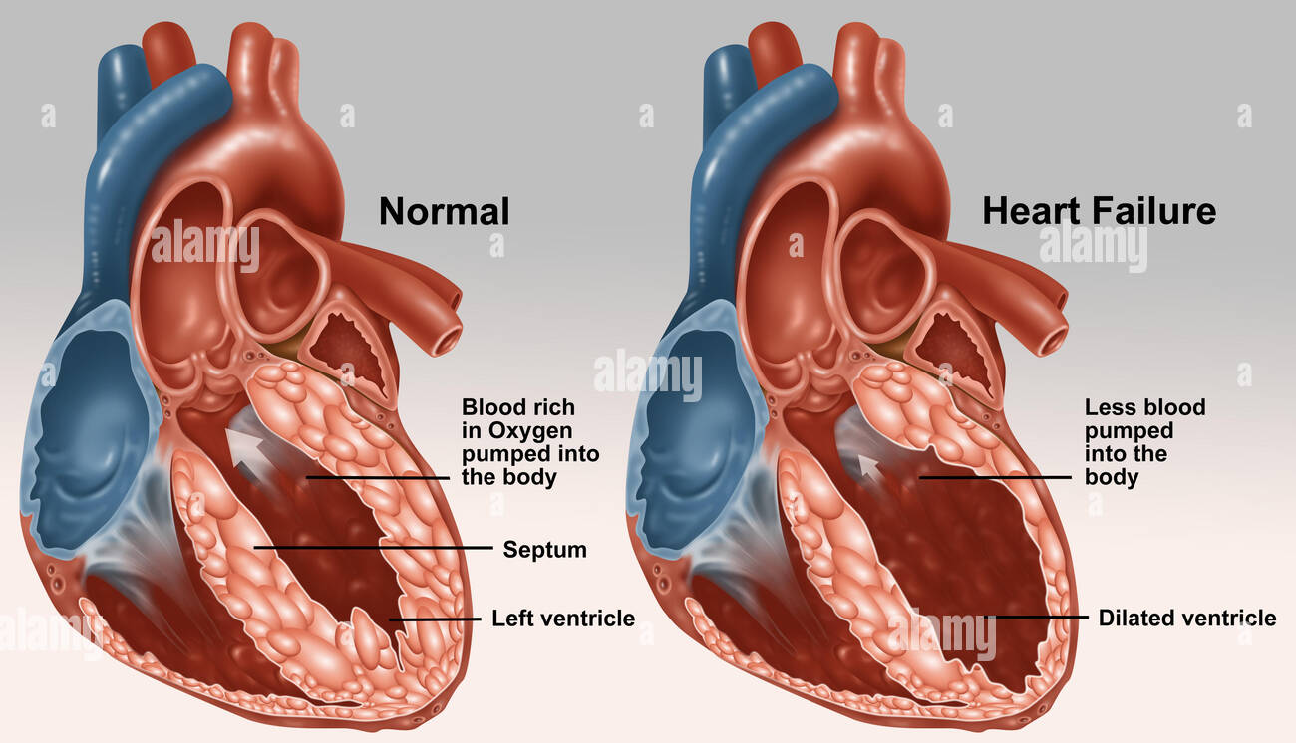
Introduction
Comparative Analysis:
Ejection Fraction: In a healthy heart, a significant percentage of blood is ejected with each beat. In heart failure, this ejection fraction decreases, indicating diminished pumping efficiency.
Symptoms Correlation: The structural and functional changes in heart failure lead to symptoms such as fatigue, shortness of breath, and fluid retention.
Figure 3: Visual representation comparing the percentage of blood pumped out of the ventricles in a healthy heart versus a failing heart
Source: https://www.alamy.com/stock-photo-llustration-comparing-a-normal-heat-left-to-a-diseased-heart-undergoing-103991720.html
3

Slide 6
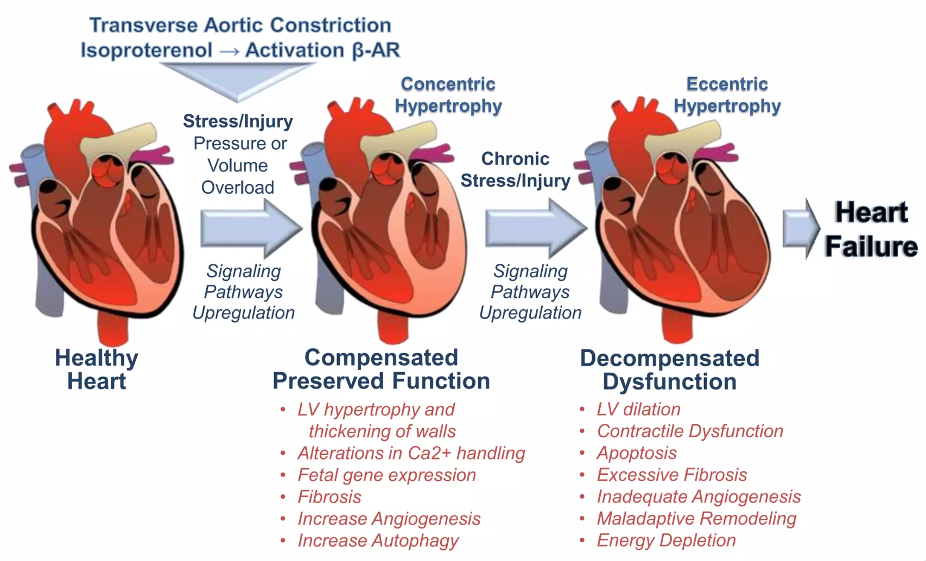
Progression of Heart Failure – From Healthy Heart to Dysfunction
1. Healthy Heart:
- Efficient blood flow and oxygen supply to the body.
- Maintains coordinated and optimal cardiac function.
2. Compensated Preserved Function:
Adaptations: LV hypertrophy, thickened walls.
Changes: Altered calcium handling, fibrosis, increased angiogenesis.
Symptoms: Often asymptomatic at this stage.
3. Decompensated Dysfunction:
Structural Changes: Ventricular dilation, contractile dysfunction, excessive fibrosis.
Functional Impairments: Energy depletion, poor pumping efficiency.
Clinical Symptoms: Fatigue, shortness of breath, fluid retention.
Figure 4: Progression of Heart Failure
4

Slide 7
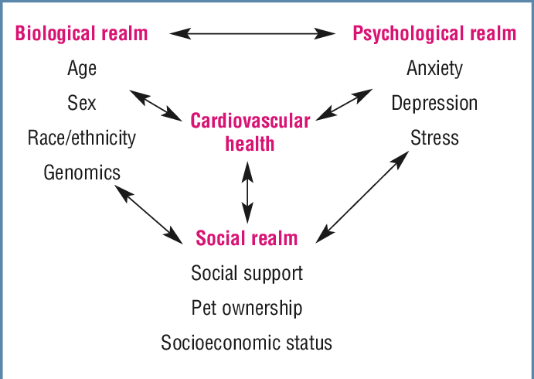
Biopsychosocial Model of Cardiovascular Health
1. Biological Realm:
Factors: Age, Sex, Race, Genetics, Genomics
Older individuals and certain ethnic groups are at higher risk for heart disease.
Genetic predisposition influences susceptibility to cardiovascular conditions.
2. Psychological Realm:
Mental health directly impacts heart health.
Key conditions: Stress, Anxiety, Depression
Chronic stress can elevate blood pressure and worsen heart function.
3. Social Realm:
Social factors: Support Systems, Socioeconomic Status, Pet Ownership
Strong social connections improve recovery rates and treatment adherence.
Socioeconomic disparities can influence access to care and treatment outcomes.
Figure 5: Biopsychosocial Model of Cardiovascular Health
5

Slide 8
Insights from Existing Research
Key Studies
Challenges in Current Research
Shah et al. (2020): KNN model achieved 90.8% accuracy for CVD prediction.
Mahmud et al. (2023): ML enhances diagnostic precision and helps develop cost-effective interventions.
Mahgoub (2023): Metamodel approaches show improved prediction accuracy.
Small datasets and limited diversity risk overfitting and reduce generalizability.
Expanding datasets and including diverse populations are crucial for reliable prediction models.
6

Slide 9
Objectives
To mitigate overfitting in prediction models by implementing
strategies tailored to small datasets and limited diversity.
To expand datasets with diverse population data to improve the reliability and generalizability of prediction models.
To validate and optimize prediction models for accurate
performance across varied and representative populations.

Slide 10
Methods & Materials

Slide 11
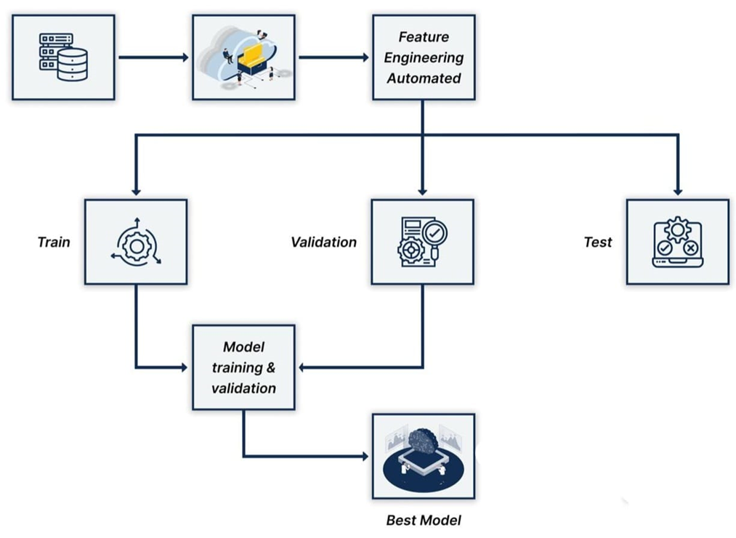
System Design Diagram of our Research
7
Figure 6 : Proposed System Design Diagram of Heart Failure Prediction using ML

Slide 12
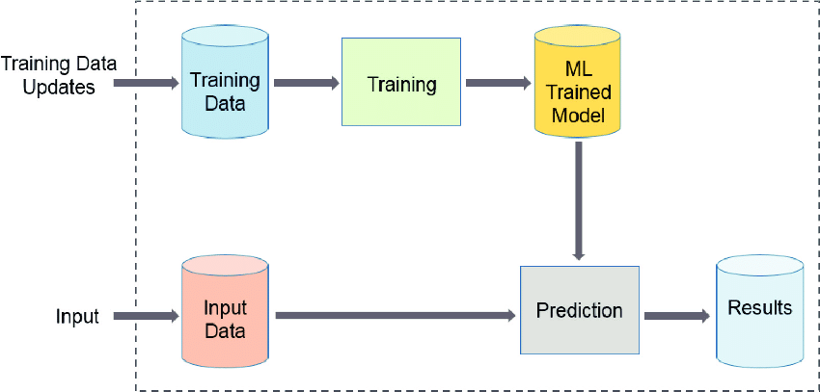
Machine Learning Workflow for Heart Failure Prediction
Early detection of HF: Reduces healthcare costs, improves outcomes, and supports personalized treatments.
Machine Learning (ML):
Analyzes complex medical datasets to identify risk factors.
Supports predictive models for better clinical decisions.
Figure 7: Machine Learning Workflow for Model Training and Prediction
8

Slide 13
Dataset Collection
Dataset Reference: Davide Chicco, Giuseppe Jurman: "Machine learning can predict survival of patients with heart failure from serum creatinine and ejection fraction alone." BMC Medical Informatics and Decision Making 20, 16 (2020). https://doi.org/10.1186/s12911-020-1023-5
01
Dataset Reference: Detrano, R., Janosi, A., Steinbrunn, W., Pfisterer, M., Schmid, J.J., Sandhu, S., Guppy, K.H., Lee, S., & Froelicher, V. "International application of a new probability algorithm for the diagnosis of coronary artery disease." Semantics Scholar. https://www.semanticscholar.org/paper/International-application-of-a-new-probability-for-Detrano-J%C3%A1nosi/a7d714f8f87bfc41351eb5ae1e5472f0ebbe0574
02
9

Slide 14
Dataset Description
Demographics
01
Age, Sex, Locality, Lifestyle
Medical History
02
Family History, Allergies, Depression, Hypertension
Clinical Measurements
Blood Pressure, Cholesterol, Fasting Blood Sugar, Maximum Heart Rate, Electrocardiogram Results
03
Heart-Specific Factors
04
Blood Pressure, Chest Pain Type, Exercise Angina, ST Depression, Slope of ST, Number of Vessels Fluro, Thallium
10

Slide 15
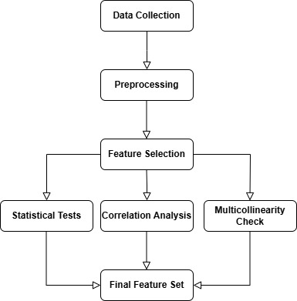
Features Selection
Steps Involved:
06
1
Statistical Tests: Chi-square tests for categorical features. T-tests for continuous features. Correlation Analysis:
Correlation matrices to assess relationships with target variables (Heart Disease, Heart Failure).
Multicollinearity Evaluation: Features with high multicollinearity were carefully assessed to avoid redundancy.
2
05
3
04
Figure 8: Feature Selection Process Flowchart
11

Slide 16
Model Training
Performance Evaluation:
Models assessed for accuracy using the ROC (Receiver Operating Characteristic) curve.
Models Trained:
06
Logistic Regression
K-Nearest Neighbors (KNN)
Gaussian Naive Bayes
Random Forest
Bagging Decision Trees
Hard Voting Classifier
1
2
05
3
4
5
04
6
12

Slide 17
Results & Discussion

Slide 18
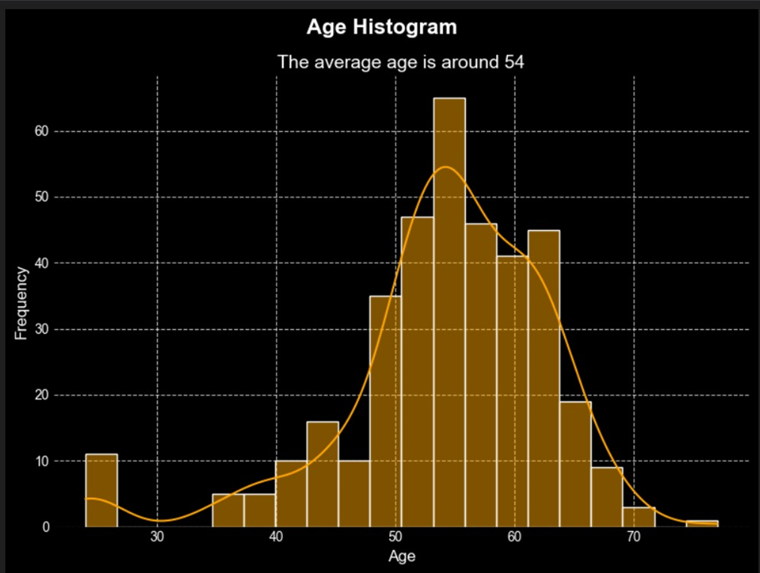
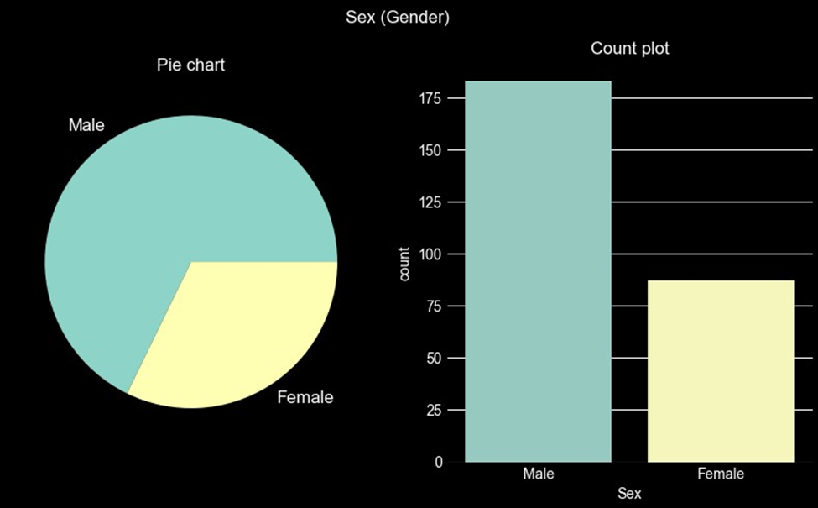
Key Findings and Insights
Exploratory Data Analysis
A
B
Figure 10: EDA of Gender
Figure 9 : EDA of Age
Gender Distribution: Males constitute 70% and females 30% of the study population.
Heart Failure Prevalence: Nearly 175 males and 85 females are affected, highlighting a higher prevalence in males.
Highest Risk Group: Peak incidence is in the 55-60 age group, with an average patient age of 54.
Contributing Factors: Aging, high blood pressure, diabetes, and poor lifestyle habits.
13

Slide 19
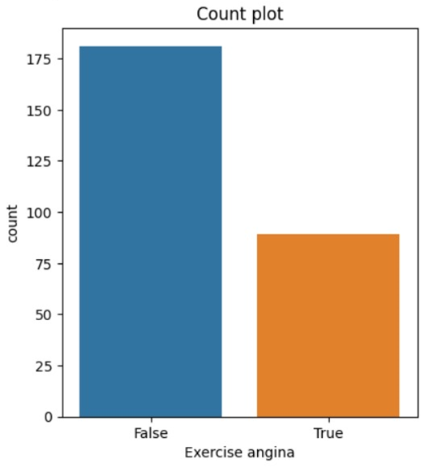
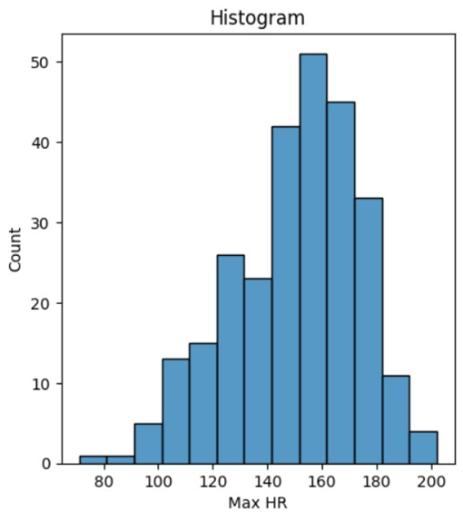
Key Findings and Insights
Exploratory Data Analysis
C
D
Figure 11 : EDA of Exercise Angina
Figure 12 : EDA of Max HR
Distribution: About 181 patients (67%) did not report exercise-induced angina, while 89 patients (33%) experienced it.
Observation: Although less prevalent, exercise angina remains a significant condition in heart failure patients.
Max HR Range: Most patients have a Max HR between 130 and 170 bpm, with a median around 150 bpm.
Peak Frequency: The highest frequency is observed between 150 and 160 bpm.
14

Slide 20
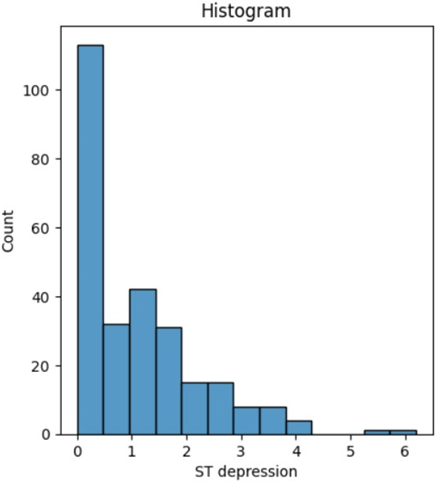
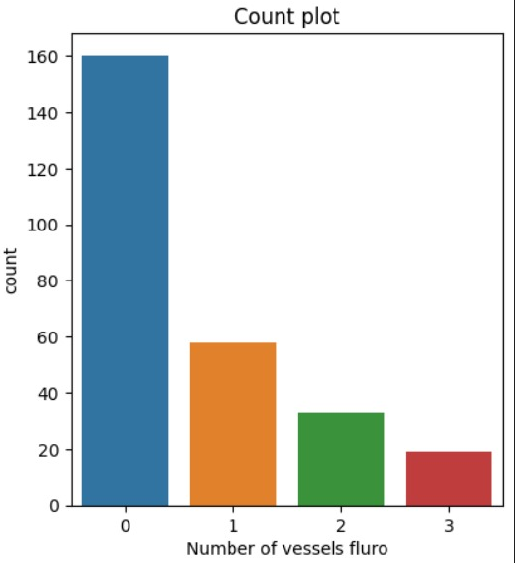
Key Findings and Insights
Exploratory Data Analysis
E
F
Figure 13 : EDA of ST Depression
Figure 14 : EDA of Number of Vessels Fluro
ST Depression Range: Most patients exhibit ST depression levels between 0 and 1, indicating mild ST depression is common.
Trend: Low to moderate ST depression levels in heart failure patients may reflect underlying ischemic conditions affecting cardiac function.
Distribution: A majority of patients (~160) have 0 major vessels with fluoroscopy, indicating severe cardiac blockage.
Progressive Decline: Fewer patients have 1, 2, or 3 major vessels, showing a decreasing trend as the number of open vessels increases.
15

Slide 21
Correlation Analysis
16
Figure 15 : Correlation Analysis Heatmap

Slide 22
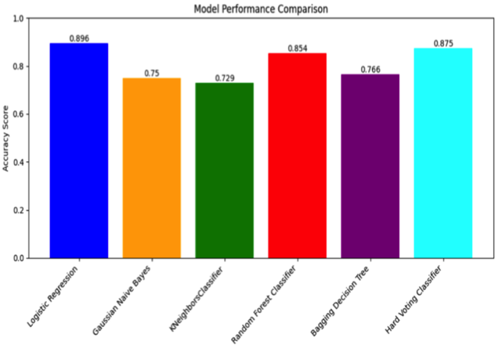
Model Performance
Best Model: Logistic Regression with the highest accuracy (0.896).
Other Models: Random Forest and Hard Voting Classifier showed strong performance (0.875 accuracy).
Moderate performance by Bagging Decision Trees (0.766) and Gaussian Naive Bayes (0.75).K-Nearest Neighbors performed the lowest (0.729 accuracy).
Figure 16: Model accuracy comparison.
17

Slide 23
Performance Metrics of Models
Figure 17 : Performance Metrics of Models (Accuracy, Precision, Recall, F1-Score)
Accuracy: Measures the proportion of correctly classified samples.
Precision: Indicates the fraction of true positive predictions among all positive predictions.
Recall: Represents the fraction of true positive predictions among actual positive cases.
F1-Score: Harmonic mean of precision and recall, balancing the two metrics.
ROC-AUC: Assesses the trade-off between sensitivity and specificity
18

Slide 24
Analysis of Results
Logistic Regression:
Achieved 89.58% accuracy; provides interpretability for clinical insights.
Struggles with capturing complex non-linear relationships.
Gaussian Naive Bayes:
Obtained 75.00% accuracy; computationally efficient but limited by the assumption of feature independence.
K-Nearest Neighbors (KNN):
Scored the lowest accuracy (72.92%) due to high dimensionality and sensitivity to feature scaling and irrelevant features.
Random Forest:
Achieved 85.42% accuracy; effectively handles non-linear relationships and provides feature importance for better insights.
Bagging Decision Trees:
Reached 87.50% accuracy, reducing variance through ensemble learning, slightly outperforming Random Forest.
Voting Classifier:
Also achieved 87.50% accuracy, combining strengths of multiple models for robust performance.
19

Slide 25
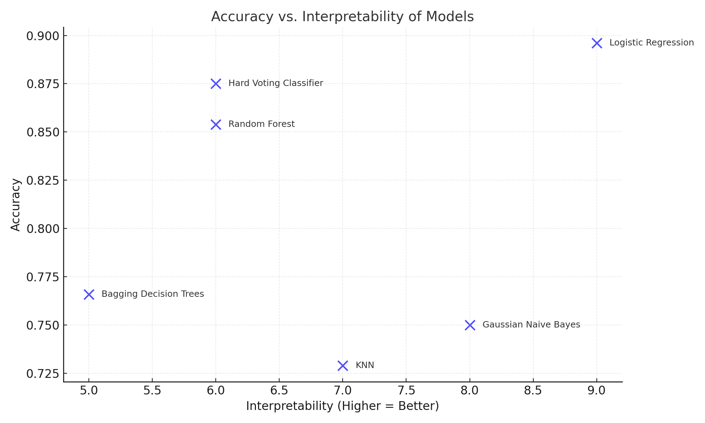
Accuracy VS. Interpretability
Logistic Regression is well-suited for the dataset due to high accuracy.
Random Forest and Hard Voting Classifier provide robust predictions with slight trade-offs in accuracy.
Lower-performing models may still be preferred for specific tasks prioritizing interpretability or simplicity.
Figure 18: Accuracy vs. Interpretability of Machine Learning Models
20

Slide 26
Limitations
Data Imbalance: The dataset exhibited class imbalance, particularly in target variables like heart failure, leading to potential bias toward the majority class.
Feature Completeness: Missing values in features such as sex and cholesterol levels required imputation, which may have introduced biases.
Model Sensitivity: Models like KNN were sensitive to hyperparameters (e.g., number of neighbors, distance metrics), impacting performance.
Interpretability vs. Complexity: Ensemble methods (e.g., Random Forest, Bagging Decision Trees) improved accuracy but reduced interpretability compared to simpler models.
21

Slide 27
Future Work
We aim to enhance our heart failure prediction models through advanced techniques:
Explore Advanced Neural Network Architectures: Utilize CNN and TabNet to uncover complex patterns in data and enhance the predictive accuracy of heart failure models.
Incorporate Data Augmentation Techniques: Employ SMOTE to address class imbalance and ensure consistent and robust model performance.
Implement Advanced Feature Engineering: Introduce domain-specific transformations and capture non-linear relationships to improve model insights and interpretability.
Optimize Model Parameters: Apply Grid Search and Bayesian Optimization for precise hyperparameter tuning, achieving optimal performance.
Leverage Ensemble Learning Methods: Combine models like Gradient Boosting Machines and meta-learners to boost prediction accuracy and reliability.
Focus on Ethical and Practical Applications: Ensure fairness, transparency, and privacy in model deployment while integrating real-time applications into clinical decision support systems and telemedicine platforms for improved patient care.
22

Slide 28
References
Chowdhury, M. N. R., E. Ahmed, M. A. D. Siddik and A. U. Zaman (2021). Heart disease prognosis using machine learning classification techniques. 2021 6th International Conference for Convergence in Technology (I2CT), IEEE.
Ishaq, A., S. Sadiq, M. Umer, S. Ullah, S. Mirjalili, V. Rupapara and M. Nappi (2021). "Improving the prediction of heart failure patients’ survival using SMOTE and effective data mining techniques." IEEE access 9: 39707-39716.
Mahgoub, A. (2023). "A Novel Approach to Heart Failure Prediction and Classification through Advanced Deep Learning Model." World Journal of Cardiovascular Diseases 13(9): 586-604.
Mahmud, I., M. M. Kabir, M. F. Mridha, S. Alfarhood, M. Safran and D. Che (2023). "Cardiac Failure Forecasting Based on Clinical Data Using a Lightweight Machine Learning Metamodel." Diagnostics (Basel) 13(15).
5. Şahin, B. and G. İlgün (2022). "Risk factors of deaths related to cardiovascular diseases in World Health Organization (WHO) member countries." Health & Social Care in the Community 30(1): 73-80.
6. Shah, D., S. Patel and S. K. Bharti (2020). "Heart disease prediction using machine learning techniques." SN Computer Science 1(6): 345.
7. Shi, T., J. Yang, N. Zhang, W. Rong, L. Gao, P. Xia, J. Zou, N. Zhu, F. Yang and L. Chen (2024). "Comparison and use of explainable machine learning-based survival models for heart failure patients." Digital Health 10: 20552076241277027.
8. Visscher, P. M., N. R. Wray, Q. Zhang, P. Sklar, M. I. McCarthy, M. A. Brown and J. Yang (2017). "10 Years of GWAS Discovery: Biology, Function, and Translation." American journal of human genetics 101(1): 5-22.
24

Slide 29
Thank You

